Slide 1
Cryptography and Network Security
BLOCK CIPHER MODES OF OPERATION

Slide 2
Session Meta Data
Author | Dr T Sree Sharmila
Reviewer
Version Number | 1.0
Release Date | 3 July 2018

Slide 3
Revision History
Revision Date | Details | Version no.
 |  | 1.0

Slide 4
Agenda
Introduction
Modes of operations
Electronic Codebook Mode
Cipher block Chaining Mode
Cipher feedback mode
Output feedback Mode
Counter Mode
Summary
Test your understanding
References

Slide 5
Introduction
DES – Modes of Operation
Advantages & Limitations of different Modes
The Five Different Modes are:
Electronic Codebook Mode
Cipher block Chaining Mode
Cipher feedback mode
Output feedback Mode
Counter Mode

Slide 6
Agenda
Introduction
Modes of operations
Electronic Codebook Mode
Cipher block Chaining Mode
Cipher feedback mode
Output feedback Mode
Counter Mode
Summary
Test your understanding
References

Slide 7
Modes of Operation
block ciphers encrypt fixed size blocks
eg. DES encrypts 64-bit blocks with 56-bit key
need some way to en/decrypt arbitrary amounts of data in practise
ANSI X3.106-1983 Modes of Use (now FIPS 81) defines 4 possible modes
subsequently 5 defined for AES & DES
have block and stream modes
Notes:
DES (or any block cipher) forms a basic building block, which en/decrypts a fixed sized block of data. However to use these in practise, we usually need to handle arbitrary amounts of data, which may be available in advance (in which case a block mode is appropriate), and may only be available a bit/byte at a time (in which case a stream mode is used). To apply a block cipher in a variety of applications, four “modes of operation” have been defined by NIST (FIPS 81). The four modes are intended to cover virtually all the possible applications of encryption for which a block cipher could be used. As new applications and requirements have appeared, NIST has expanded the list of recommended modes to five in Special Publication 800-38A. These modes are intended for use with any symmetric block cipher, including triple DES and AES.

Slide 8
Modes of Operation
Block modes:
Electronic Codebook Book (ECB)
Message is broken into independent blocks of 64 bits
Cipher Block Chaining (CBC)
Message is broken in independent blocks of 64 bits, but next input depends of previous output
Ci= Ek (Pi⊕Ci-1), with C-1=IV

Slide 9
Modes of Operation
Stream Modes
Cipher FeedBack (CFB)
The message is xored with the feedback of encrypting the previous block
C_{i}=P_{i}⊕E_{k}(C_{i-1}), with C₋₁=IV
Output feedback
The feedback is independent of the message
C_{i}=P_{i}⊕E_{k}(O_{i-1}), with O₋₁=IV

Slide 10
Agenda
Introduction
Modes of operations
Electronic Codebook Mode
Cipher block Chaining Mode
Cipher feedback mode
Output feedback Mode
Counter Mode
Summary
Test your understanding
References

Slide 11
Electronic Codebook Book (ECB)
message is broken into independent blocks which are encrypted
each block is a value which is substituted, like a codebook, hence name
each block is encoded independently of the other blocks
C_{i} = DES_{K1}(P_{i})
uses: secure transmission of single values
Notes:
The simplest mode is the electronic codebook (ECB) mode, in which plaintext is handled one block at a time and each block of plaintext is encrypted using the same key. ECB is the simplest of the modes, and is used when only a single block of info needs to be sent (eg. a session key encrypted using a master key).

Slide 12
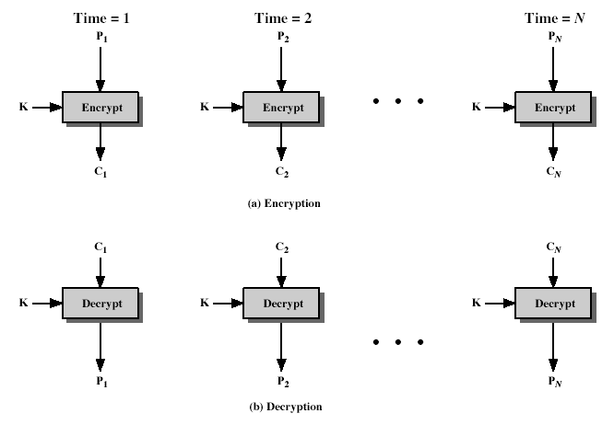
Electronic Codebook Mode(ECB)
Notes:
Stallings Figure 6.3 illustrates the Electronic Codebook (ECB) Mode.

Slide 13
Advantages and Limitations of ECB
message repetitions may show in ciphertext
if aligned with message block
particularly with data such graphics
or with messages that change very little, which become a code-book analysis problem
weakness is due to the encrypted message blocks being independent
main use is sending a few blocks of data
Notes:
ECB is not appropriate for any quantity of data, since repetitions can be seen, esp. with graphics, and because the blocks can be shuffled/inserted without affecting the en/decryption of each block. Its main use is to send one or a very few blocks, eg a session encryption key.

Slide 14
Agenda
Introduction
Modes of operations
Electronic Codebook Mode
Cipher block Chaining Mode
Cipher feedback mode
Output feedback Mode
Counter Mode
Summary
Test your understanding
References

Slide 15
Cipher Block Chaining (CBC)
message is broken into blocks
linked together in encryption operation
each previous cipher blocks is chained with current plaintext block, hence name
use Initial Vector (IV) to start process
C_{i} = DES_{K1}(P_{i} XOR C_{i-1})
C₋₁ = IV
uses: bulk data encryption, authentication
Notes:
To overcome the problems of repetitions and order independence in ECB, want some way of making the ciphertext dependent on all blocks before it. This is what CBC gives us, by combining the previous ciphertext block with the current message block before encrypting. To start the process, use an Initial Value (IV), which is usually well known (often all 0's), or otherwise is sent, ECB encrypted, just before starting CBC use. CBC mode is applicable whenever large amounts of data need to be sent securely, provided that all data is available in advance (eg email, FTP, web etc).

Slide 16
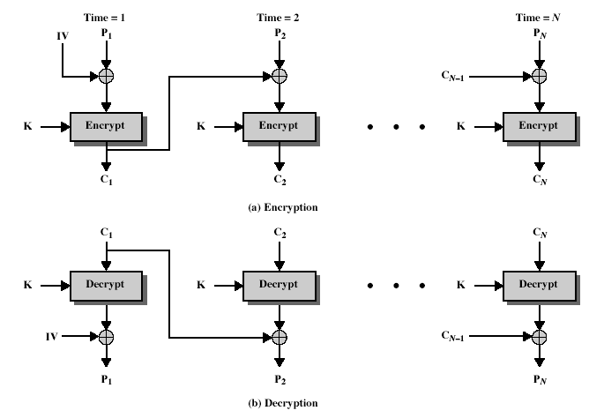
Cipher Block Chaining (CBC)
Notes:
Stallings Figure 6.4 illustrates the Cipher Block Chaining (CBC) Mode.

Slide 17
Message Padding
at end of message must handle a possible last short block
which is not as large as blocksize of cipher
pad either with known non-data value (eg nulls)
or pad last block along with count of pad size
eg. [ b1 b2 b3 0 0 0 0 5]
means have 3 data bytes, then 5 bytes pad+count
this may require an extra entire block over those in message
there are other, more esoteric modes, which avoid the need for an extra block
Notes:
One issue that arises with block modes is how to handle the last block, which may well not be complete. In general have to pad this block (typically with 0's), and then must recognise padding at other end - may be obvious (eg in text the 0 value should usually not occur), or otherwise must explicitly have the last byte as a count of how much padding was used (including the count). Note that if this is done, if the last block IS an even multiple of 8 bytes or has exactly the same form as pad+count, then will have to add an extra block, all padding so as to have a count in the last byte. There are other, more esoteric, “ciphertext stealing” modes, which avoid the need for an extra block.

Slide 18
Advantages and Limitations of CBC
a ciphertext block depends on all blocks before it
any change to a block affects all following ciphertext blocks
need Initialization Vector (IV)
which must be known to sender & receiver
if sent in clear, attacker can change bits of first block, and change IV to compensate
hence IV must either be a fixed value
Notes:
CBC is the block mode generally used. The chaining provides an avalanche effect, which means the encrypted message cannot be changed or rearranged without totally destroying the subsequent data. However there is the issue of ensuring that the IV is either fixed or sent encrypted in ECB mode to stop attacks on 1st block.

Slide 19
Agenda
Introduction
Modes of operations
Electronic Codebook Mode
Cipher block Chaining Mode
Cipher feedback mode
Output feedback Mode
Counter Mode
Summary
Test your understanding
References

Slide 20
Cipher FeedBack (CFB)
message is treated as a stream of bits
added to the output of the block cipher
result is feed back for next stage (hence name)
standard allows any number of bit (1,8, 64 or 128 etc) to be feed back
denoted CFB-1, CFB-8, CFB-64, CFB-128 etc
most efficient to use all bits in block (64 or 128)
C_{i} = P_{i} XOR DES_{K1}(C_{i-1})
C₋₁ = IV
uses: stream data encryption, authentication
Notes:
If the data is only available a bit/byte at a time (eg. terminal session, sensor value etc), then must use some other approach to encrypting it, so as not to delay the info. Idea here is to use the block cipher essentially as a pseudo-random number generator (see stream cipher lecture later) and to combine these "random" bits with the message. Note as mentioned before, XOR is an easily inverted operator (just XOR with same thing again to undo). Again start with an IV to get things going, then use the ciphertext as the next input. As originally defined, idea was to "consume" as much of the "random" output as needed for each message unit (bit/byte) before "bumping" bits out of the buffer and re-encrypting. This is wasteful though, and slows the encryption down as more encryptions are needed. An alternate way to think of it is to generate a block of "random" bits, consume them as message bits/bytes arrive, and when they're used up, only then feed a full block of ciphertext back. This is CFB-64 or CFB-128 mode (depending on the block size of the cipher used eg DES or AES respectively). CFB is the usual choice for quantities of stream oriented data, and for authentication use.

Slide 21
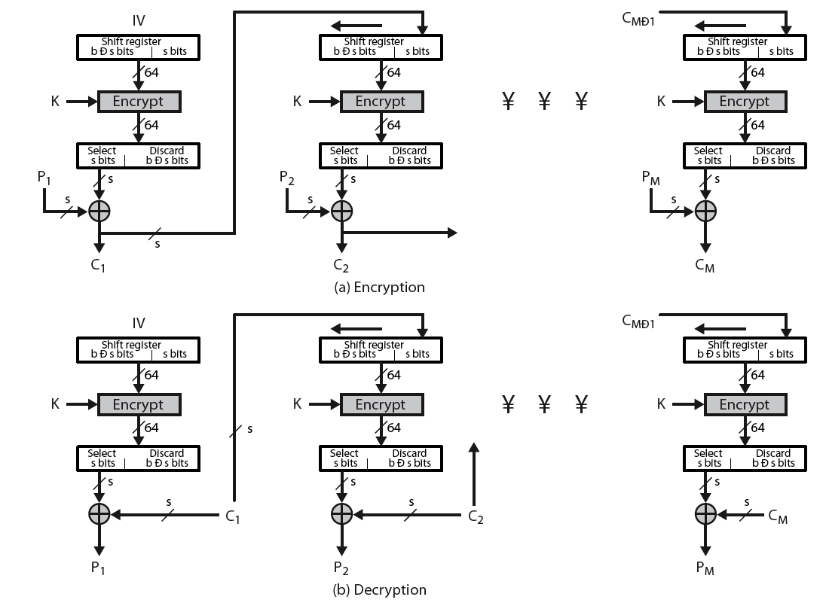
Cipher FeedBack (CFB)
Notes:
Stallings Figure 6.5 illustrates the Cipher FeedBack (CFB) Mode.

Slide 22
Advantages and Limitations of CFB
appropriate when data arrives in bits/bytes
most common stream mode
limitation is need to stall while do block encryption after every n-bits
note that the block cipher is used in encryption mode at both ends
errors propogate for several blocks after the error
Notes:
CFB is the usual stream mode. As long as can keep up with the input, doing encryptions every 8 bytes. A possible problem is that if its used over a "noisy" link, then any corrupted bit will destroy values in the current and next blocks (since the current block feeds as input to create the random bits for the next). So either must use over a reliable network transport layer (pretty usual) or use OFB.

Slide 23
Agenda
Introduction
Modes of operations
Electronic Codebook Mode
Cipher block Chaining Mode
Cipher feedback mode
Output feedback Mode
Counter Mode
Summary
Test your understanding
References

Slide 24
Output FeedBack (OFB)
message is treated as a stream of bits
output of cipher is added to message
output is then feed back (hence name)
feedback is independent of message
can be computed in advance
C_{i} = P_{i} XOR O_{i}
O_{i} = DES_{K1}(O_{i-1})
O₋₁ = IV
uses: stream encryption on noisy channels
Notes:
The alternative to CFB is OFB. Here the generation of the "random" bits is independent of the message being encrypted. The advantage is that firstly, they can be computed in advance, good for bursty traffic, and secondly, any bit error only affects a single bit. Thus this is good for noisy links (eg satellite TV transmissions etc).

Slide 25
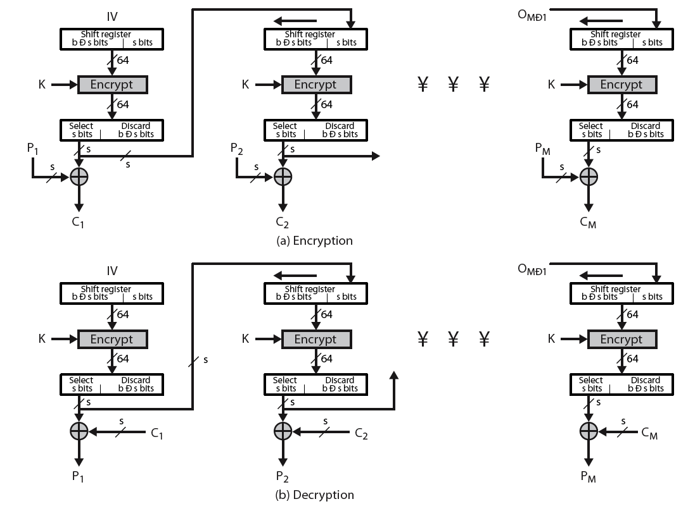
Output FeedBack (OFB)
Notes:
Stallings Figure 6.6 illustrates the Output FeedBack (OFB) Mode.

Slide 26
Advantages and Limitations of OFB
bit errors do not propagate
more vulnerable to message stream modification
a variation of a Vernam cipher
hence must never reuse the same sequence (key+IV)
sender & receiver must remain in sync
originally specified with m-bit feedback
subsequent research has shown that only full block feedback (ie CFB-64 or CFB-128) should ever be used
Notes:
One advantage of the OFB method is that bit errors in transmission do not propagate. The disadvantage of OFB is that it is more vulnerable to a message stream modification attack than is CFB.
Since OFB is a Vernam cipher variant, the stream should never be used more than once (otherwise the 2 ciphertexts can be combined, cancelling these bits, and leaving a "book" cipher to solve). And sender & receiver need to remain in sync, or all data is lost. Also, research has shown that you should only ever use a full block feedback ie OFB-64/128 mode.

Slide 27
Agenda
Introduction
Modes of operations
Electronic Codebook Mode
Cipher block Chaining Mode
Cipher feedback mode
Output feedback Mode
Counter Mode
Summary
Test your understanding
References

Slide 28
Counter (CTR)
a “new” mode, though proposed early on
similar to OFB but encrypts counter value rather than any feedback value
must have a different key & counter value for every plaintext block (never reused)
C_{i} = P_{i} XOR O_{i}
O_{i} = DES_{K1}(i)
uses: high-speed network encryptions
Notes:
The Counter (CTR) mode is a variant of OFB, but which encrypts a counter value (hence name). Although it was proposed many years before, it has only recently been standardized for use with AES along with the other existing 4 modes. It is being used with applications in ATM (asynchronous transfer mode) network security and IPSec (IP security). A counter, equal to the plaintext block size is used. The only requirement stated in SP 800-38A is that the counter value must be different for each plaintext block that is encrypted. Typically the counter is initialized to some value and then incremented by 1 for each subsequent block.

Slide 29
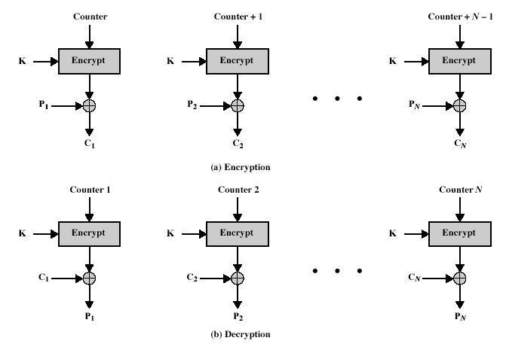
Counter (CTR)
Notes:
Stallings Figure 6.7 illustrates the Counter (CTR) Mode.

Slide 30
Advantages and Limitations of CTR
efficiency
can do parallel encryptions in h/w or s/w
can preprocess in advance of need
good for bursty high speed links
random access to encrypted data blocks
provable security (good as other modes)
but must ensure never reuse key/counter values, otherwise could break (cf OFB)
Notes:
CTR mode has a number of advantages in parallel h/w & s/w efficiency, can preprocess the output values in advance of needing to encrypt, can get random access to encrypted data blocks, and is simple. But like OFB have issue of not reusing the same key+counter value.

Slide 31
Agenda
Introduction
Modes of operations
Electronic Codebook Mode
Cipher block Chaining Mode
Cipher feedback mode
Output feedback Mode
Counter Mode
Summary
Test your understanding
References

Slide 32
Summary
Studied Five Different Modes of operation
Electronic Codebook Mode
Cipher block Chaining Mode
Cipher feedback mode
Output feedback Mode
Counter Mode

Slide 33
Agenda
Introduction
Modes of operations
Electronic Codebook Mode
Cipher block Chaining Mode
Cipher feedback mode
Output feedback Mode
Counter Mode
Summary
Test your understanding
References

Slide 34
Test your understanding
Explain different block cipher modes of operations.
What are the advantages and disadvantages of cipher block chaining mode?
List out the limitations of cipher feedback mode.

Slide 35
Agenda
Introduction
Modes of operations
Electronic Codebook Mode
Cipher block Chaining Mode
Cipher feedback mode
Output feedback Mode
Counter Mode
Summary
Test your understanding
References

Slide 36
References
1. William Stallings, Cryptography and Network Security, 6th Edition, Pearson Education, March 2013.
2. Charlie Kaufman, Radia Perlman and Mike Speciner, “Network Security”, Prentice Hall of India, 2002.

